Slide 1
The future(s) of terrorism and Canadian national security
Preliminary Research Findings from a TSAS-sponsored project Friday, May 30, 2014 Jez Littlewood

Slide 2
PROJECT OUTLINE
PROMISED
DELIVERED
Assess possible futures of terrorism over the next decade;
Focus on
Canadian demographics and ethnocultural diversity;
terrorist targets and target selection evolution; and,
terrorist groups and ideologies.
Literature review, basic foresight techniques & interviews with experts
Preliminary assessment of possible future of terrorism in next five years (2014-2019)
Focus on
Canadian demographics and ethnocultural diversity;
Foreign fighters
Literature review and assessment of existing data, including grey literature.
Notes:
The rationale behind the project.
First, because Canada is a multicultural state and is likely to become more diverse in the future given the envisaged continuation of approximately 250,000 immigrants arriving annually over the next decade; why does this matter? Principally because it is assumed that super-diversity can, inter alia, potentially increase the risk of violence as social cohesion and identity may become more acute at individual, community, and other levels. This is not to say that terrorism is inevitable or causally linked to immigration, however there is an assumption that Canada imports ‘other people’s wars’ and that the changing nature of Canada’s ethnocultural mosaic may give rise to right wing extremism.
Two developments resulted in an altered focus. The first was the scale and scope of the foreign fighter phenomenon connected to Syria and other conflict areas which appeared to be a more immediate and medium term development vis-à-vis terrorism in Canada that warranted further investigation. The second was the high likelihood of continuation of funding for a future of terrorism project through to March 2016 for which some of the original plans for this research could be more appropriately pursued in greater detail, in particular that related to ideologies motivating terrorism and that related to targets and weapons-selection issues. Postponed foresight methods and interviews to later project.

Slide 3
three underlying assumptions
(1) that Canada would continue to face a low-level, persistent, and diverse terrorism threat, as it has over the last 40 years;
(2) that no systematic campaign within Canada would emerge in the next five years, i.e. nothing similar the Irish republican threat in the UK; and,
(3) that the predominant threat to Canada over the next five years would remain from al Qaeda inspired terrorist groups, cells, or individuals.

Slide 4
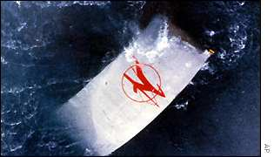
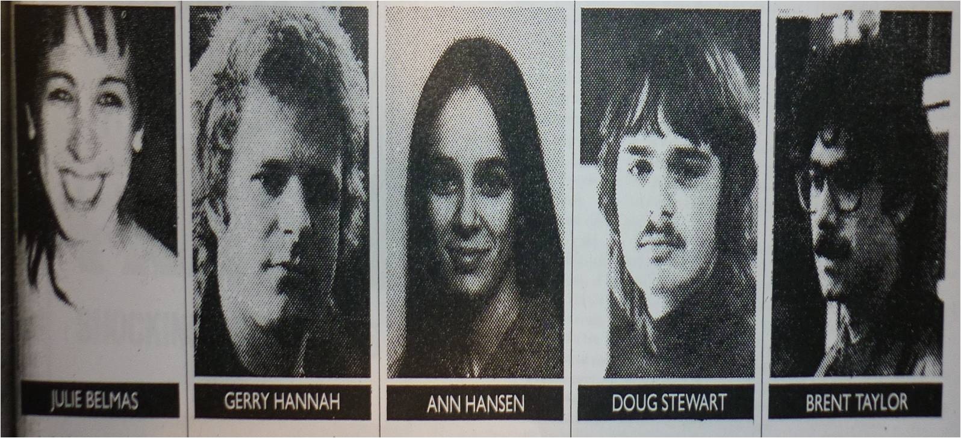
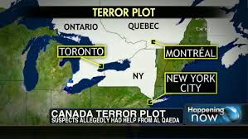
Baseline of terrorism
Low-level; few systematic campaigns; diverse ideologies
Thwarted plots etc.: Khawaja; TO-18 (11); Namouh
On-going/pending trials: August 2010; VIA Rail; BC Canada Day plot
Material support & trials abroad
250 individuals under investigation in 2011
2012 Crime stats: 114 incidents (62 hoaxes) vs. 59 incidents 2011.

Slide 5
Visible minority population and top three visible minority groups, Canada, 2011
 | Total population number | Visible minority population number percentage |  | Top 3 Visible minority groups
Canada | 32,852,325 | 6,264,755 | 19.1 | South Asian, Chinese, Black
Toronto | 5,521,235 | 2,596,420 | 47.0 | South Asian, Chinese, Black
Montreal | 3,752,475 | 762,325 | 20.3 | Black, Arab, Latin American
Vancouver | 2,280,695 | 1,030,335 | 45.2 | Chinese, South Asian, Filipino
Ottawa-Gatineau | 1,215,735 | 234,015 | 19.2 | Black, Arab, Chinese
Calgary | 1,199,125 | 337,420 | 28.1 | South Asian, Chinese, Filipino
Edmonton | 1,139,585 | 254,990 | 22.4 | South Asian, Chinese, Filipino
Winnipeg | 714,635 | 140,770 | 19.7 | Filipino, South Asian, Black
Hamilton | 708,175 | 101,600 | 14.3 | South Asian, Black, Chinese
Source: Statistics Canada (2013) ‘Immigration and Ethnocultural Diversity in Canada’ National Household Survey, 2011 p.17)

Slide 6
Religious identity and affiliation
33,476,688 pop.; 6,775,800 foreign born (20.6%) 200 ethnic origins; 6.25 million identified as visible minority (19%)
Just over two-thirds of the population (67.3%) reported an affiliation with a Christian religion,
Nearly one-quarter reported no religious affiliation.
Slightly over one million identified themselves as Muslims (3.2%),
498,000 identified themselves as Hindu (1.5%),
455,000 identified themselves as Sikh (1.4%),
366,800 identified themselves as Buddhists (1.1%) and
329,500 identified themselves as Jewish (1.0%).

Slide 7
‘[w]hile Canada is capable of generating some terrorism of its own, the most severe danger has been imported as potential terrorists and terrorist supporters creep in almost unnoticed with the tide of newcomers arriving here every year.’ (Thompson & Turlej ;2002; 2)
Parent & Ellis (2011) 21 cases of Radicalization 2002-2011
Mullins (2013) 1991-2011 35 individuals pre-9/11 & 29 individuals post-9/11
Non-AQ-inspired data – suggests material support offences
Diaspora communities in the West will remain prominent in the financing, recruitment and political support for overseas insurgent groups and, to a lesser extent for transnational terrorist organisations, operating against targets located in the West. ... Conflicts over immigration issues and ethnic minorities will persist, leading periodically to incidents of hate crimes and low-level political terrorism and, more rarely, serious campaigns of inter-communal violence. In the long run, there is , also a distinct possibility that new forms of ‘home-grown’ ethnic terrorism may arise, linked to the new ethnic diaspora communities or in violent opposition to these. (Lia; 2005; 141)
The studied population does include the 24 people who have been charged to date with offences under Canada’s Anti-Terrorism Act…. Significantly, 75 per cent of these individuals are Canadian citizens. This is important because, before and during the Sept. 11, 2001 attacks, adherents to terrorist causes in the West were mostly seen as immigrants who had imported their ideology from abroad. … Yet Canadian-born radicals now “represent a plurality” of those identified as violent…. (Freeze;; 2013;)

Slide 8
Mosaic Institute report (2014)
data on eight conflict zones – North and South Sudan; the Horn of Africa (predominantly Ethiopia, Eritrea, Somalia); the Middle East (with specific reference to the Israel/Palestine conflict); Afghanistan; Armenia/Turkey; the countries of the former Yugoslavia; Sri Lanka; and India/Pakistan
‘[w]hat our research found is that regardless of where or what conflict people come from, or what we endured during or as a result of it, we don’t “import” conflict in its “back home” form when we come to Canada.’
‘Canadians imagine that overseas conflict will hurt us, and we imagine that newer Canadians, or Canadians who come from places where violent conflict persists, will bring their conflict with them in ways that could hurt us.’
‘In fairly short order, Canadians who come from conflict don’t view violence in Canada as helpful to their cause, their people, or their “side” of the overseas conflict.’

Slide 9
But…
authors stress findings do not ‘suggest that no individual Canadians ever become radicalized in Canada, or support extremist and even violently extremist viewpoints or organizations.’
Violence abroad
To stay or to go?
“armed resistance, but only over there”;
“If the other side refuses to talk, it is okay to pick up the sword, but only there, not here.”
“sometimes it feels as though vio­lence is the only way that people can stand up against the violence that is being done to them. I would never advocate violence here – …never advocate for violence against the Canadian government or people.”
“Violence works for Afghanistan – there. Putting fear in foreigners’ minds and telling them to get out.”
Hegghammer (2013) , ‘when Western jihadists first considered using violence they were… more likely to join a distant warzone than attack at home.’
Mullins (2013) Canada’s experience prior to 9/11 involved, predominantly, individuals going abroad, or using Canada as a base for planning, recruitment, and support for terrorist activity.

Slide 10
Foreign Fighters
Malet (2013) – FFs in more than one in five civil wars last 200 years
Hegghammer (2011) – 10,000 to 30,000 Muslim FFs since 1980
Whitaker et al (2012) – 1,700 Canadians in Spanish Civil war; Malet (2013) Canadians in Israeli War of Independence;
Syria as the current focus: estimates vary: up to 11,000 Sunni FFs in Syria (Dec.2013) & claim of 40,000 Shia FFs helping Assad (Feb. 2014)
Testimony Feb.3, 2014 “CSIS is aware of over 130 Canadians who are abroad” – not all in combat; 80 known returnees (probable different baseline/time?)
Fear that they will return - ‘they were Communists who now possessed military training, making them capable of ‘carry[ing] out in Canada what they learned in Spain’ – ‘guerilla warfare and the building of barricades, etc..’

Slide 11
The looser and fragmented nature of violent extremist jihadist groups has been characterised as one that is segmented, polycentric, and ideologically integrated (SPIN). As the study notes when applied to al Qaeda:
Segmentary means ‘composed of many diverse groups, which grow and die, divide and fuse, proliferate and contract.’
Polycentric means ‘having multiple, often temporary, and sometimes-competing leaders or centers of influence.’ And,
Networked means, ‘forming a loose, reticulate, integrated network with multiple linkages through travelers, overlapping membership, joint activities, common reading matter, and shared ideals.’
Ronfeldt, David. (2008). ‘Al-Qaeda and Its Affiliates’ (Santa Monica, CA.; RAND) cited in Cilluffo, Frank, J., Jeffrey B. Cozzens, Magnus Ranstorp. (2010). ‘Foreign Fighters Trends, Trajectories & Conflict Zones’ p.9. (As the reference in the Cilluffo et al study notes, ‘David Ronfeldt adapted this model from Luther Gerlach’s study in 1987 which focus[es] on social movements in the 1960s.’

Slide 12
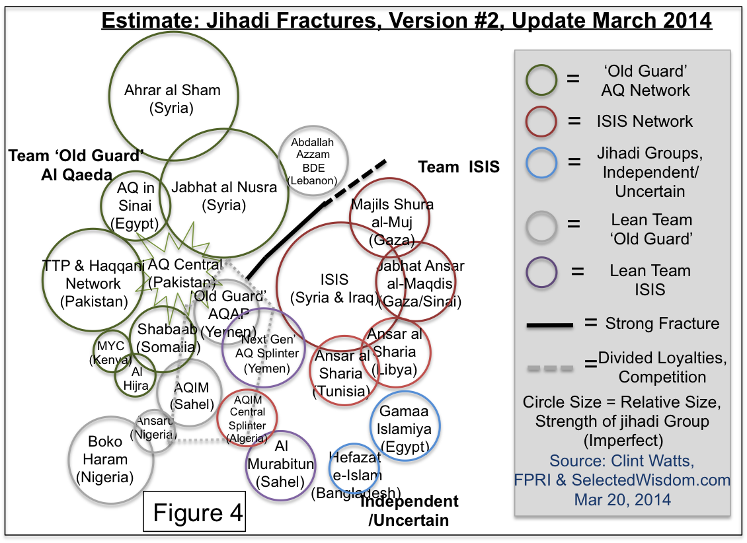

Slide 13
Probable real problems
All returnees don’t pose a danger: Most do not return. Hegghammer suggests 1 in 9 returnees, others 1 in 10, pose a threat;
Evidence of thwarted plots on return in France and UK (a Mumbai-style armed assualt)
Even 1 in 10 suggests 100+ experienced radicalized Westerners; for Canada? 4-10? 10-15? unknown
Another decade-long problem – up to 2020-2025?
Diversity of Canadians – no longer just Montreal, GTA, but smaller cities across Canada

Slide 14
The Canadian data – if correct or correctly interpreted here – suggests, as the Mosaic report concludes, that other people’s wars only affect Canada’s national security at a low level. That low level is sufficient to justify security concerns, but it does not suggest significant contemporary or future waves of terrorism, systematic campaigns, or existence of thousands of extremists perpetrating violence. Canada generates its own terrorists and some of these are newcomers but most appear to be born here. Moreover, recent studies and the data suggest traveling abroad to conduct violence is more common that targeting the homeland.

Slide 15
Conclusions
Project falls prey to Bakker’s justified criticism of forecasts on terrorism ‘two very obvious and not very specific conclusions’ – terrorism will continue to occur and the threat will evolve over time…, ‘most forecasts say more about the present state of terrorism…than predicting the future.’
Peak of AQ-inspired attacks against west; Jihadi activity is thriving; Possible second wave of Western attacks 4-6 years from now (Hegghammer, 2013).
Fragmentation of groups (grouplets) a challenge + post9/11 generation of new radicalized individuals
For Canada: AQ-inspired likely main threat for next five years; other terrorism possible; Travel abroad, material support, and Canadians returning key challenges.
Issue is not whole communities of newcomers or minority groups.

