Slide 1
Between Here and There: Pre- and Post-migration Experiences and Generalized Trust among Recent Immigrants in Canada
Antoine Bilodeau (Concordia)
Stephen E. White (Concordia)

Slide 2
Generalized trust
Smoothing mechanism to social interactions between members of a given society
Component of Civic Culture (Almond & Verba 1963; Inglehart 1993)
Greater compliance for paying taxes (Scholz and Lubell 1998)
Positive perception of personal health (Helliwell 2003)
Greater life satisfaction (Rostila 2007)
Likely critical for immigrant integration
Immigrants are ‘outsiders’ in host-society
Unfamiliar with day-to-day norms of host-society
Generalized trust: expression of immigrants’ resilience in the face of social, economic, and political challenges?

Slide 3
Are immigrants trustful in other citizens?
Very few studies on this question (Dinesen and Hooghe 2010)
Two questions:
How much generalized trust do recent immigrants exhibit in comparison to other Canadians?
Why are some immigrants trustful and others not?
Is generalized trust rooted in pre-migration experiences?
Socialization experiences: culture
Is generalized trust rooted in post-migration experiences?
Integration experiences: discrimination, economic aspirations…

Slide 4
Pre-MIGRATION EXPERIENCES & GENERALIZED TRUST
Generalized trust can be thought of as norm-driven:
“something inherited through socialization, (…) it is not primarily based on personal experience or other information.” (Nannestad 2008, 415)
Implications for immigrants:
Pre-migration experience might shape immigrants’ generalized trust
Those from countries with high levels of trust should be more trustful
Generalized trust would “travel” with immigrants

Slide 5
Post-MIGRATION EXPERIENCES & GENERALIZED TRUST
Generalized trust can be thought of as being grounded in the institutional structure of a society
It varies with societal conditions and reflects individual experiences (Stolle 2002: 408)
Implications for immigrants:
Generalized trust is shaped by integration experiences in Canada
Those with positive economic outcomes might be more trustful
Those who experience discrimination might be less trustful
Naturalization might lead to greater trust
What about length of residence?

Slide 6
Research design & data
World Values Surveys
2000 & 2006 Canadian component (for local population)
2000 & 2006 New immigrant Survey
TO, MTL, VA. N=1058. All in Canada for up to 10 years
WVS in country of origin of immigrants
Immigrants grouped in three categories
Low (0-25%), moderate (25.1-40%) and high (+40%) levels of generalized trust in country of origin
Measuring generalized trust:
“Generally speaking, would you say that most people can be trusted or that you can’t be too careful in dealing with people?”

Slide 7
Generalized trust (GT) among recent immigrants

Slide 8
Generalized trust among recent immigrants controlling for education levels
Entries are predicted results based on binary logit analysis controlling for socio-economic situation.

Slide 9
Beyond Generalized trust: trust in canadians
“How much do you trust Canadian people in general? Completely, somewhat, not very much, not at all.”
A particularized form of trust?
Among Canadian-born population: unlikely
Among recent immigrants: maybe
Generalized trust and Trust in Canadians – expectations
Generalized more grounded in pre-migration experiences
Trust in Canadians more grounded in post-migration experiences

Slide 10
trust in canadians among recent immigrants
2006 WVS and NIS only

Slide 11
PRE- AND POST-MIGRATION EXPERIENCES
AND TRUST AMONG RECENT IMMIGRANTS
Results report predicted probabilities derived from multivariate analyses
among recent immigrants

Slide 12
trust in country of origin and trust among immigrants
2006 WVS and NIS only

Slide 13
Pre-migration economic situation and trust among immigrants
2006 WVS and NIS only

Slide 14
treatment by canadian government and trust among immigrants
2006 WVS and NIS only

Slide 15
Citizenship acquisition and trust among immigrants:
2006 WVS and NIS only

Slide 16
Length of residence and trust among immigrants
2006 WVS and NIS only

Slide 17
conclusions
Immigrants possess great stock of trust
Both pre- and post-migration origins
Policy implications – Generalized trust
Immigrants who arrive with rich stock of generalized trust will show resilience in the face of difficult integration
Policy implications – Trust in Canadians
Canada has a role to play in fostering greater trust in Canadians
Liberal citizenship approach help consolidate link with host society
Fighting discrimination programs
But which form of trust matters more for immigrant civic and political integration: generalized or in Canadians?
Notes:
Closing comment: thanks to TSAS support, who supported us with this grant, we will able to continue studying these questions with the Provincial Diversity Project,

Slide 18
Thank you!

Slide 19
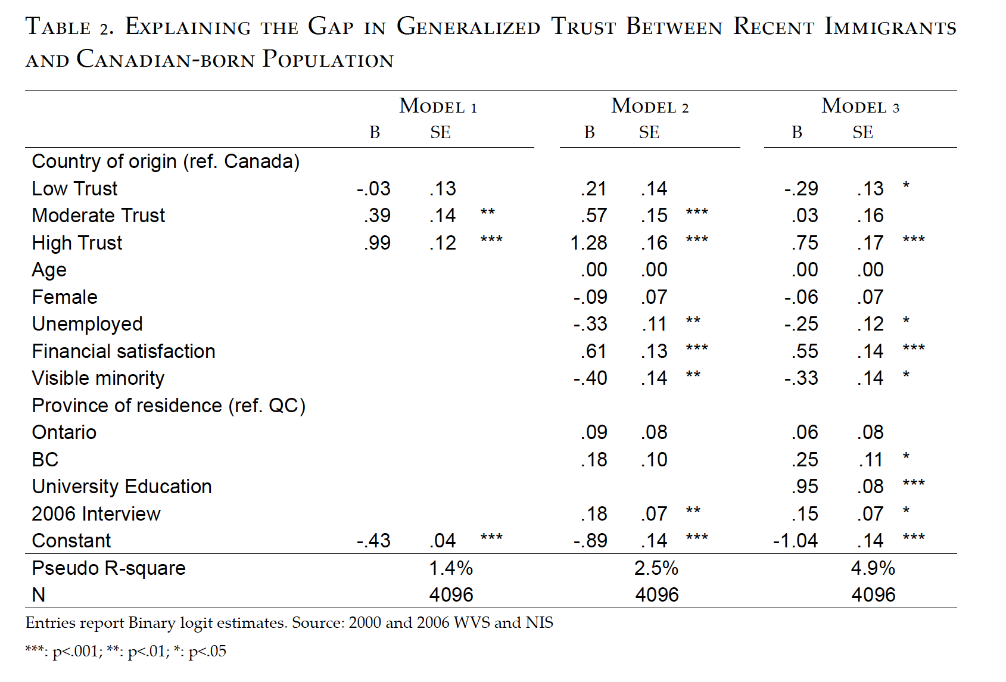

Slide 20
