Slide 1
Perceptions of Muslim Faith, Ethno-Cultural Community Based and Student Organizations in Countering Domestic Terrorism in Canada
Kawser Ahmed, MPhil
Alexander Salt
Dr. James Fergusson, PhD
Centre for Defense and Security Studies University of Manitoba, Winnipeg, MB

Slide 2
Sequence:
Part - I
Research Design
Project Phases
Data Collection and Analysis
Research Participants Profile
Research Limitations
Part - II
Factors Contributing to the Causes of Domestic Terrorism
Socio-Political Isolation
Islamophobia
Family Level conflict
Intervention and Community Mobilization
Framing of Terrorism – Jihad, Media and the Socio-Political Discourse
Evaluation of Existing Federal CT Efforts
Hopes and Dreams and the Future Trend of Domestic Terrorism
Part – III
Recommendations

Slide 3
Part – I
The Muslim community in Canada, if not throughout the West, perceives itself as a community under attack. Every Muslim is a potential terrorist, despite the nuances that exist within government policy statements. If not, why is government engagement undertaken by security agencies only?
The net result is an atmosphere of suspicion and fear within Canada’s Muslim community, which, naturally, directly affects the engagement process between state agencies and the community.

Slide 4
Phase One: The reviews of relevant literature, an analysis of existing CT are undertaken. an analysis of pertinent information from STATSCAN datasets (National household survey-NHS, 2011, Profile of Visible Minority Datasets, General Social Survey (GSS).
Phase Two: The generation of the formal research methodology and questionnaire, tested in a pilot study undertaken involving one FBO and one ECBO.
Phase Three: Primary research was conducted with a selected FECBOs and few student based organizations through in-depth, semi-structured interviews with leaders/key members.

Slide 5
We used purposive sampling by only focusing on the key leaders and personalities of each FBO, ECBO and student organization. We collected data from two sources: first from interviewing individuals and also from holding focus group discussions. Participant observations were also carried out in 5 events.
Qualitative study (ethnographic).
QSR nVivo 10 used for data analysis and report generation.

Slide 6
What is a ‘community’? Who is included and who is excluded?
A community might generally be thought of as consisting of individuals, groups and institutions based in the same area and/or having shared interests.
The term community, however, is complex and widely debated, and subject to different interpretations that cover a variety of more ore less overlapping notions. ‘Communities of interest’ bring together individuals, groups and institutions that have one or more interests in common.
Source: OSCE, Good practices in building Police-Public Partnerships, note 6 cited in Preventing terrorism and countering violent extremism and radicalization that lead to terrorism, a community policing approach, OSCE publication, 2014, p,61-62.

Slide 7
Research Participants’ Profile
Number of participants (n=21) | Distribution (ECBOs and student groups) | Age range
Male (n=14) | N=6 ECBO N=8 Students | 40-60 (FECBO members) 20-25 (Student group members)
Female (n=7) | N= 3 ECBO N= 4 Students | 40-50 (FECBO members) 20-25 (Student group members)
Note: Among the Muslims, one was from Shiite community, one from the Ahmadiyaa community and the rest were Sunnis.
Number of organizations participated |  | Remarks
Muslim FBO | 3 (n=3) | MIA, ISSA, CMLI
Muslim ECBO | 3 (n=3) | Bangladesh, Kenya, Somalia, Syria, Lebanon

Slide 8
Number of student group participated in Focus group discussion |  | Remarks
4 |  | Mixed group of Arab, Africa, South Asian backgrounds.
PARTICIPANT PROFILE | N | Age 20-30 | Age 40-60
Total | 21
Male | 14 | 8 | 6
Female | 7 | 4 | 3
Sunni | 19 | 11 | 8
Non-Sunni | 2 |  | 2
FBO | 3 | 1 | 2
ECBO | 5 | 3 | 2
Student organizations | 4 | 4

Slide 9
Research Limitations
We could not get access to a greater number of Muslim FBOs due to a prevailing atmosphere of fear and mistrust.
Such kind of qualitative research where participant observations is involved requires more time to complete.
English was a second language for some of the participants.
Bias in data collection might occur from explaining the research context and interview questions, especially when the participants do not have enough information on the topic.

Slide 10
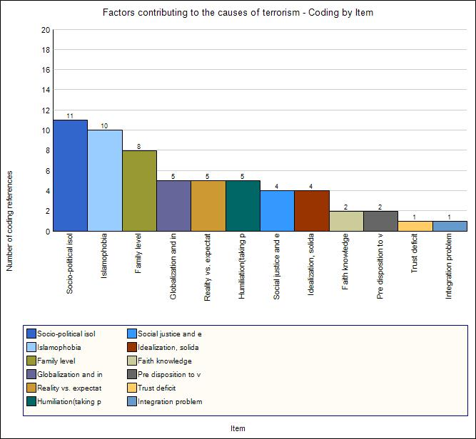
Part – II: Research Findings
FACTORS CONTRIBUTING TO THE CAUSES OF DOMESTIC TERRORISM

Slide 12
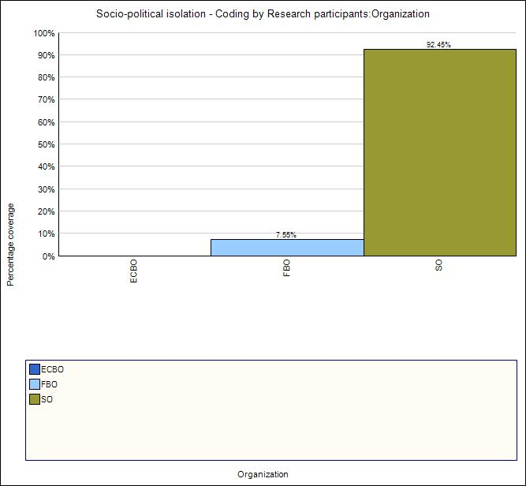
SOCIO POLITICAL ISOLATION REPORTED BY ORGANIZATIONS

Slide 13
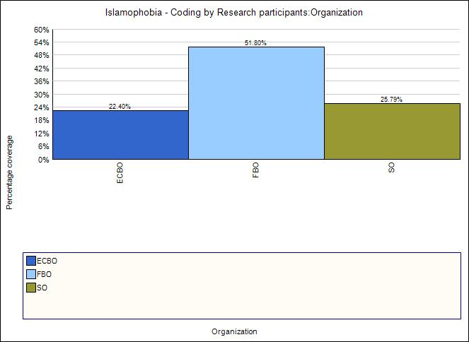
ISLAMOPHOBIA REPORTED BY ORGANIZATIONS

Slide 14
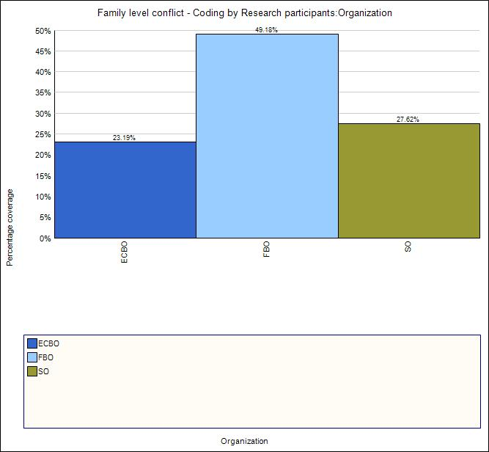
FAMILY LEVEL CONFLICT CONTRIBUTING TO TERRORISM
REPORTED BY ORGANIZATIONS

Slide 15
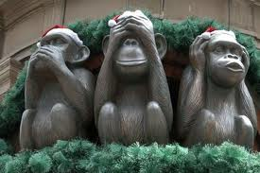
Discussion on terrorism is a social taboo

Slide 16
INTERVENTION AND COMMUNITY MOBILIZATION

Slide 17
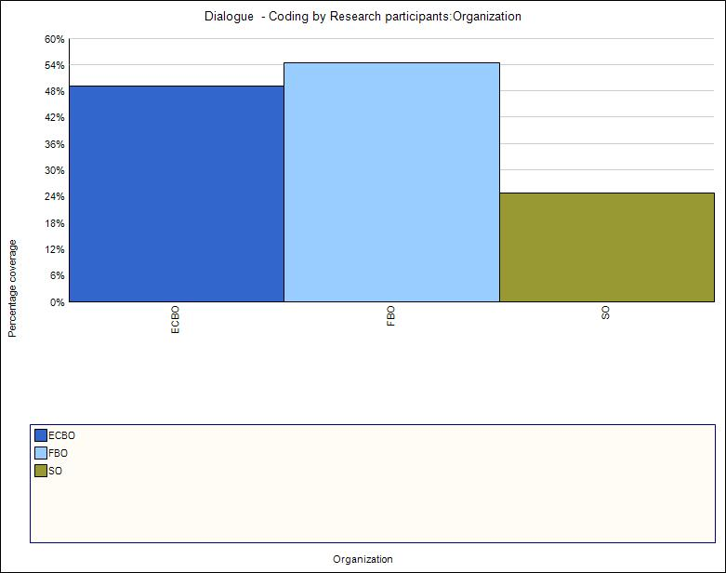
USE OF DIALOGUE AS AN INTERVENTION TOOL REPORTED BY ORGANIZATIONS

Slide 20
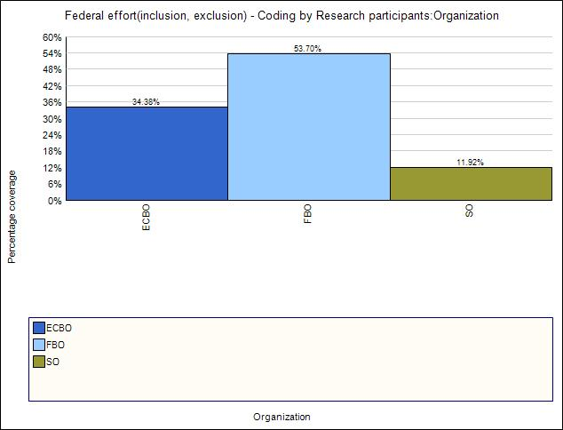
EXCLUSION AND INCLUSION IN THE CT EFFORT REPORTED BY ORGANIZATIONS

Slide 22
Radicalization of thoughts
Radicalization
Radicalization in actions

Slide 23
JIHAD AND TERRORISM PERCEPTION REPORTED BY ORGANIZATIONS

Slide 24
‘JIHAD’ AND ITS USE REPORTED BY ORGANIZATIONS

Slide 25
EVALUATION OF EXISTING FEDERAL CT EFFORTS

Slide 27
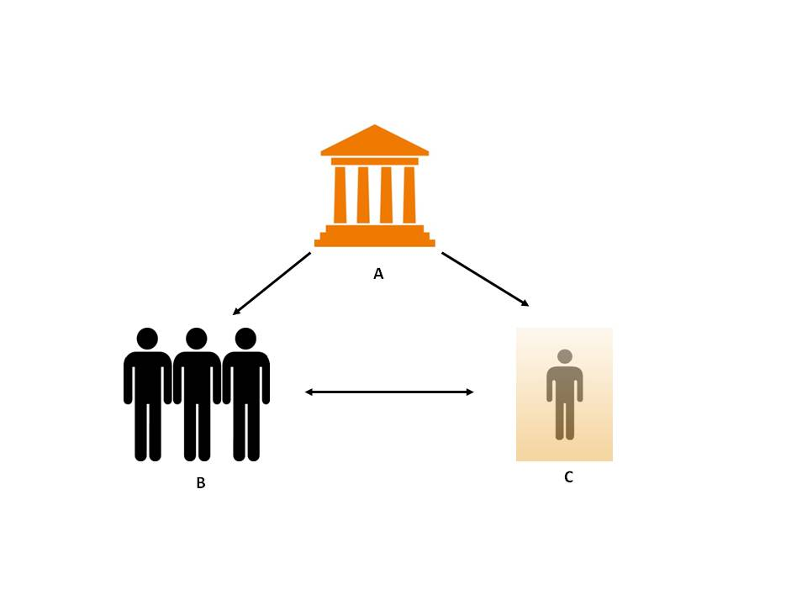
Fear Matrix

Slide 28
Counter Terrorism is inherently political, thereby it is a struggle to win:
Through political conversation.
Influence over constituency and legitimacy.
Source: Professor Dr. Bill Braniff, University of Maryland.

Slide 29
Part – III: Recommendations
Similar qualitative studies should be undertaken with a larger sample.
We recommend exploring resources available at provincial and local levels, and ways to link them with federal resources to formulate a comprehensive federal-provincial CT framework based on community mobilization.
Future research possibilities: the youth radicalization process, ECBOs and their contribution in terrorism interventions and foreign fighters of Canada and its future.
The language used in the government official publications and strategies must take into account the religious sensitivities of a particular group of people.
Ethically conducting research is imperative but while supplying the respondents with Informed Consent Form and asking them to sign it created an uneasy situation and it eventually shut down many respondents. We recommend that only verbal consent should be taken to conduct field work in the future.

Slide 30
Two questions:
Can we liberate terrorism discourse from ‘taboo’?
Have we done enough in terms of community based intervention? Can we do more?

Slide 31
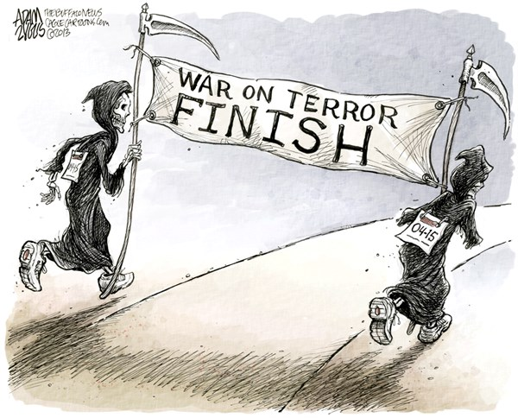
http://www.cagle.com/2013/04/marathon-terrorism/

